Slide 1
RTP CHILLER BYPASS 方式

Slide 2
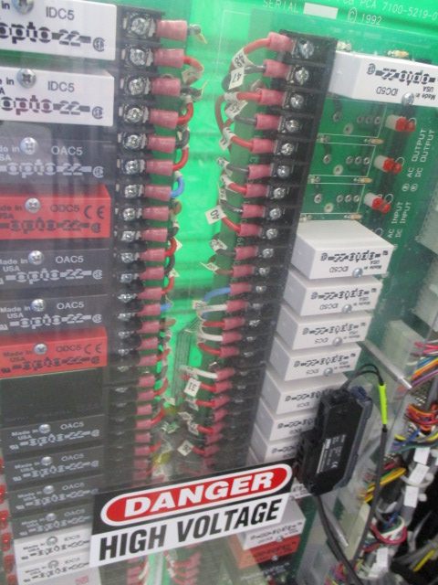
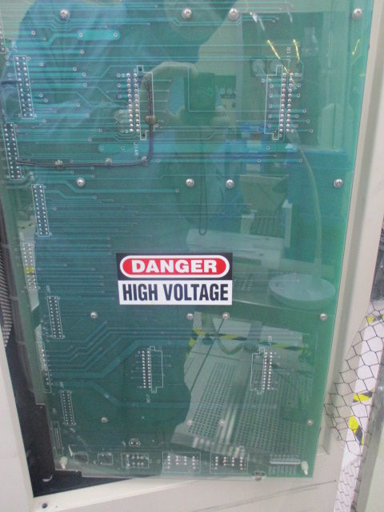
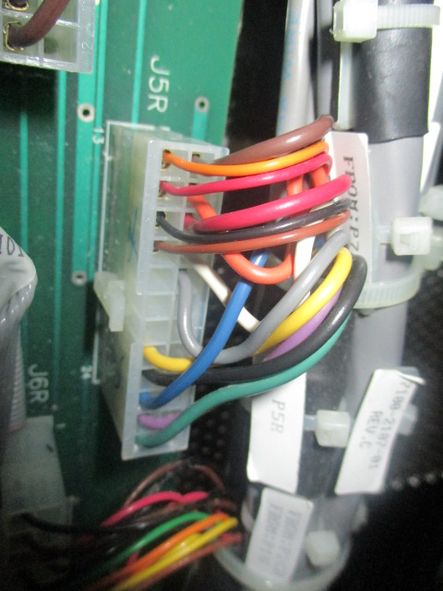
AG8108 Relay panel
Relay panel backside JR5 connect

Slide 3

Pin 13/14 connect bypass.
Pin 15/16 connect bypass.
拆下機台外蓋 door → relay panel → 將面板外翻將 J5R connect pin
13/14 ,15/16 bypass.
Check machine power on 無 chiller flow alarm.

